Slide 1


Life Expectancy Prediction Using Machine Learning
Sanket Shendge

Slide 2
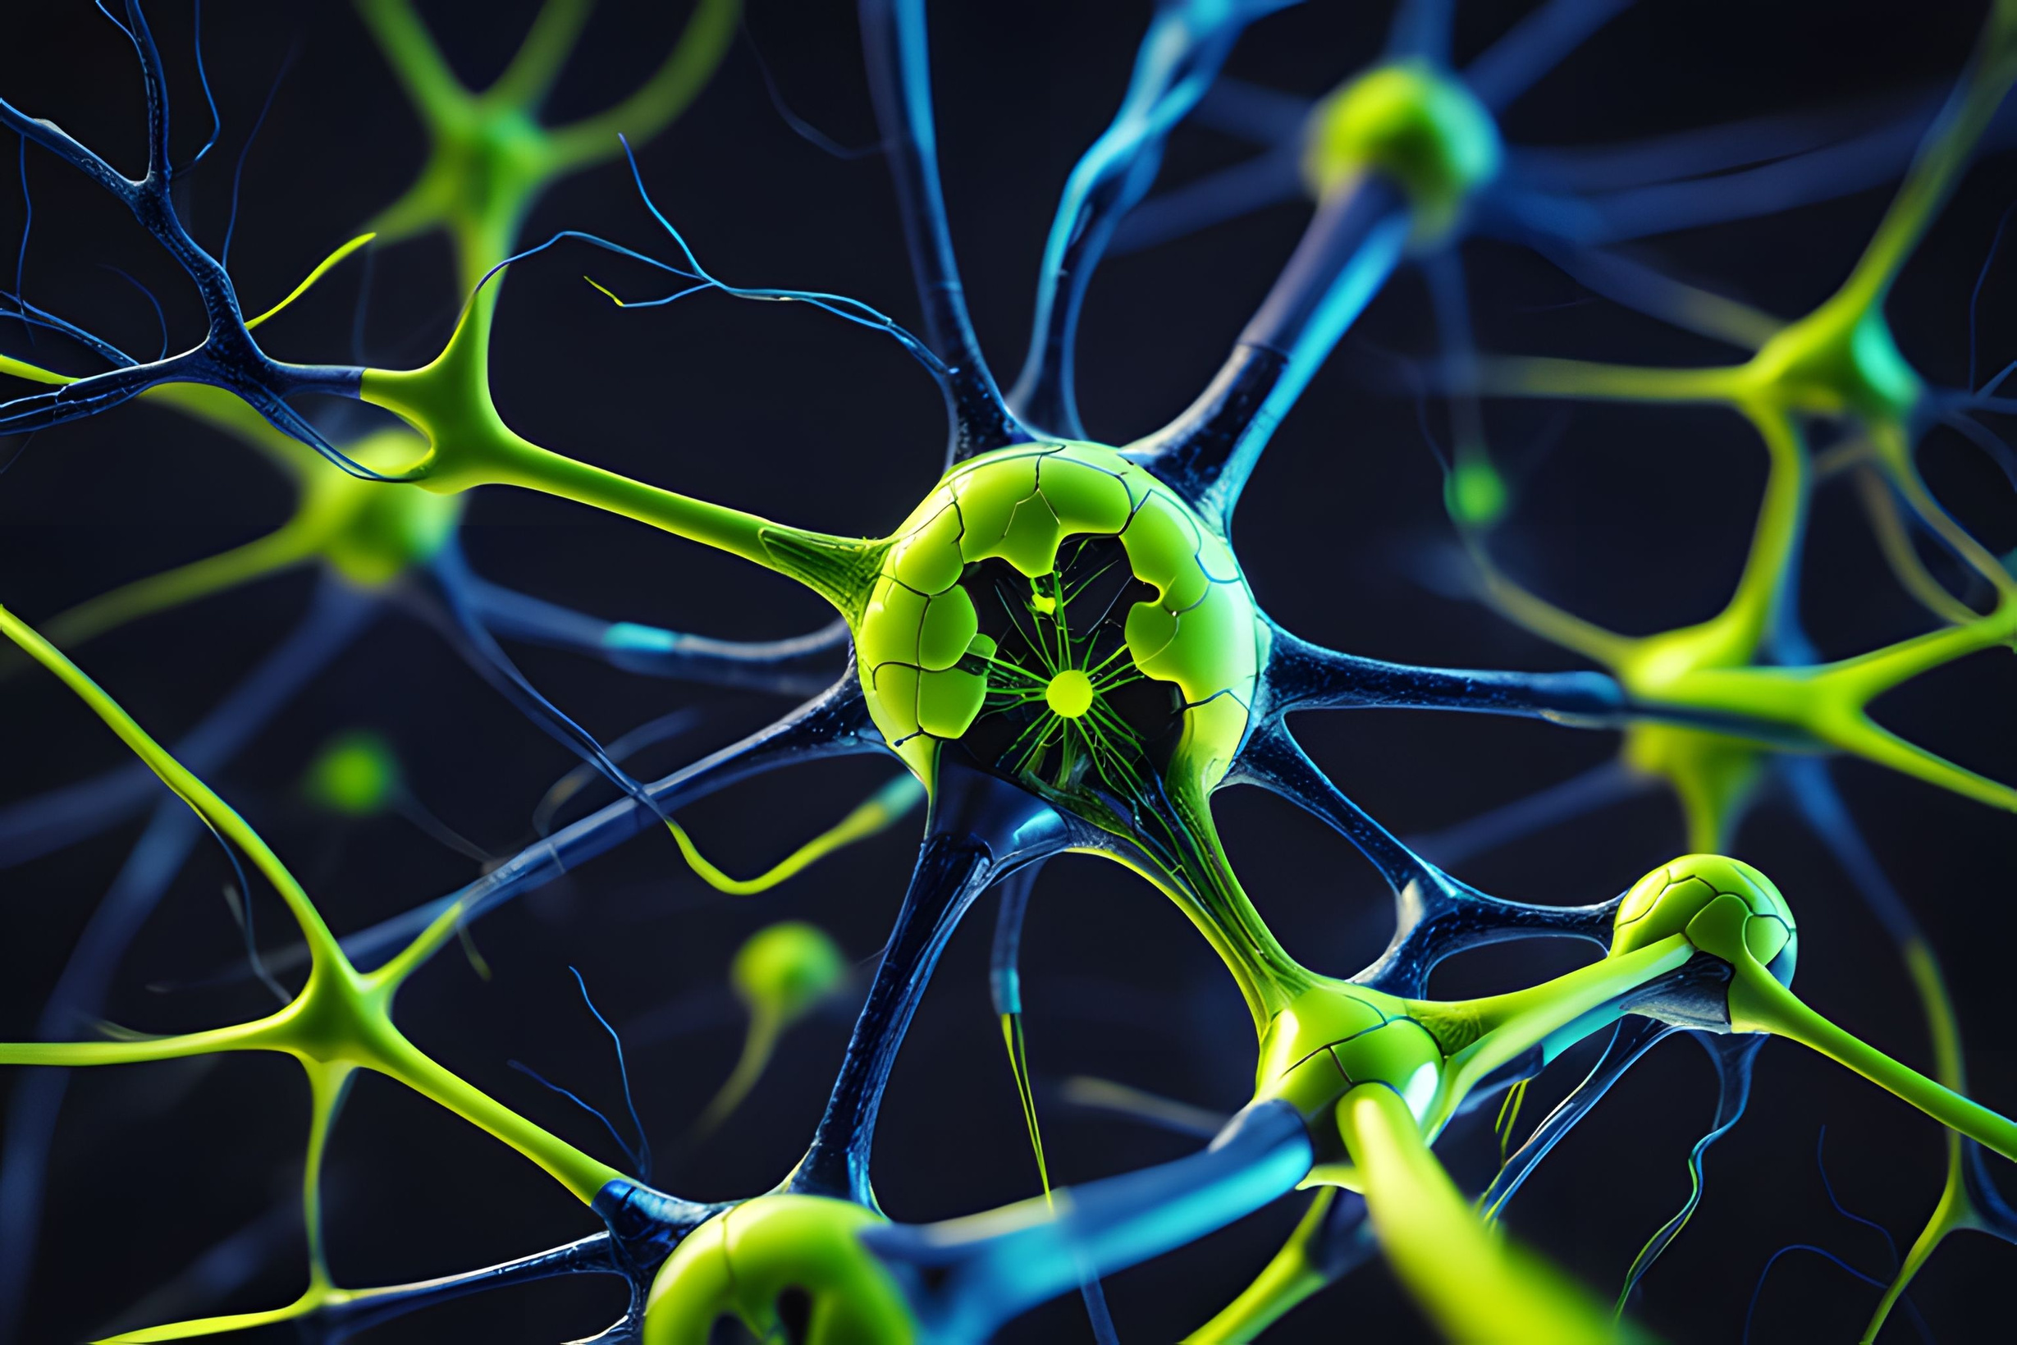
1
Introduction and Project Overview

Slide 3

What is Life Expectancy?
Life expectancy is the average number of years a person is expected to live based on current mortality rates.
It serves as a key indicator of health, quality of life, and development in a country.
Why is Life Expectancy Important ?
Reflects a country’s healthcare system efficiency.
Helps governments in policy-making and resource allocation.
Indicates economic and social well-being of a population.
Essential for public health planning and interventions.

Slide 4

Problem Statement
Life expectancy is influenced by multiple factors, including healthcare, economy, immunization, and lifestyle choices.
Predicting life expectancy helps in public health planning and policy-making.
Various factors impact accuracy, including data availability, missing values, and model selection.
Objective
Key Challenges
Build a machine learning model to predict life expectancy based on socio-economic, health, and demographic factors.
Provide insights for governments, healthcare organizations, and policymakers to improve public health.
Identifying the most significant factors affecting life expectancy.
Handling missing or inconsistent data in real-world scenarios.
Selecting the best machine learning model for accurate predictions.

Slide 5
2
Project Details and Planning

Slide 6
Dataset Columns
Country
Year
Status
Life expect
Adult Mortality
Name of the country
Year of data collection
Development status (Developed / Developing)
Life expectancy in years (Target variable)
Probability of dying between 15-60 years per 1000 population
Infant deaths
Alcohol
Percentage expenditure
HepatitisB
Measles
Number of infant deaths per 1000 live births
Per capita alcohol consumption (liters per person)
Government healthcare expenditure as a percentage of GDP
Immunization coverage (%) for Hepatitis B
Number of reported measles cases per 1000 population
BMI
Under five deaths
Polio
Total expenditure
Diphtheria
Average Body Mass Index of the population
Number of deaths of children under five years per 1000 live births
Immunization coverage (%) for Polio
Total health expenditure as a percentage of GDP
Immunization coverage (%) for Diphtheria

Slide 7
Dataset Columns
HIV_AIDS
GDP
Population
Thinness 1-19 years
Deaths per 1000 population due to HIV/AIDS
Gross Domestic Product per capita
Total population of the country
Percentage of malnourished population aged 1-19 years
Thinness 5-9 years
Income composition of resources
Schooling
Percentage of malnourished population aged 5-9 years
Human Development Index (HDI) based on income
Average number of years of schooling

Slide 8
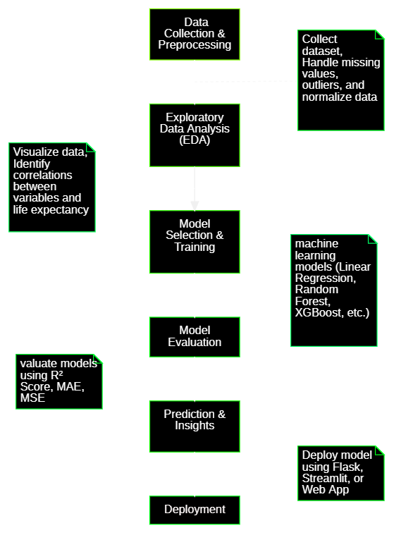
Flow Chart

Slide 9
STEPS TAKEN IN DATASET ANALYSIS AND MODEL BUILDING
Importing necessary libraries.
Fetching information about the data.
Exploratory data analysis.
Dropping the un-necessary columns and fetching the categorical and numerical columns.
Outlier removal using numerical columns.
Use min-max scaler for scaling the numerical columns.
Use label encoder for categorical columns
Dropping the columns using correlation ,skewness and kurtosis.
Oversampling for the unbalanced dataset
Model building using different classification algorithms.
Hyperparameter tuning for random forest
Conclusion

Slide 10
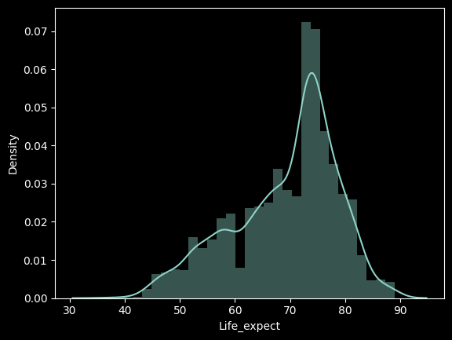
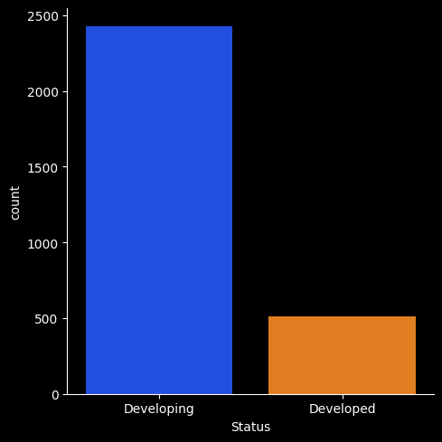
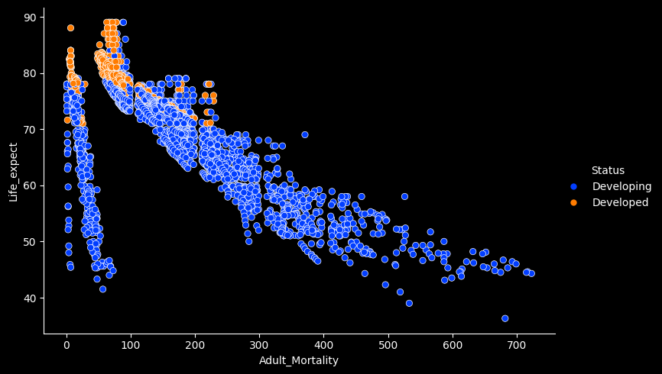
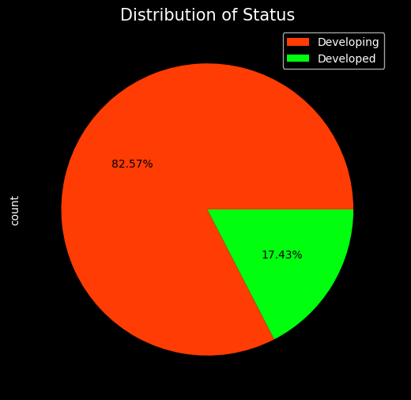
EDA

Slide 11
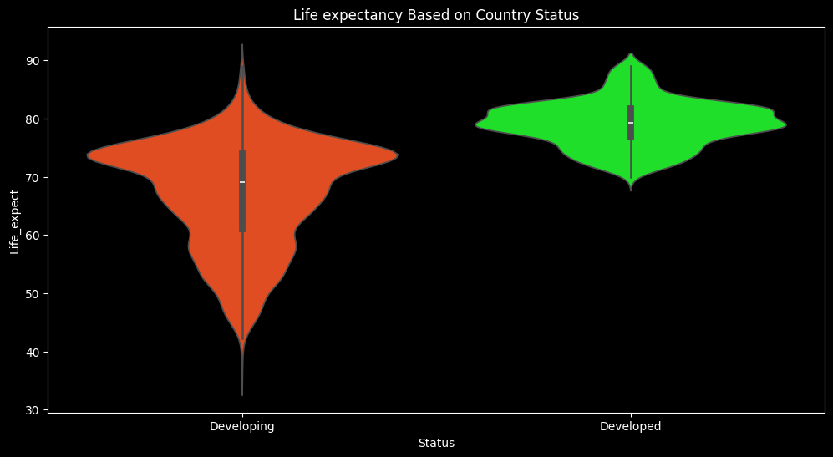
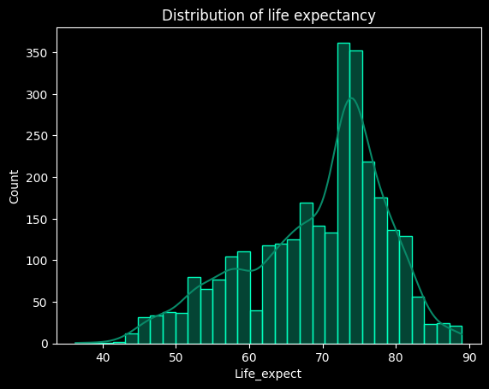
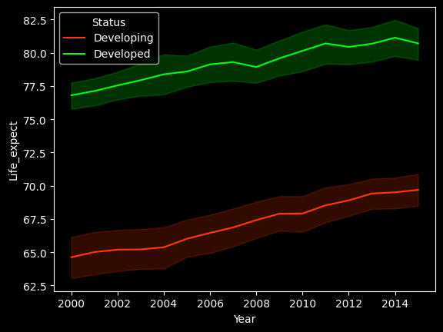
EDA

Slide 12
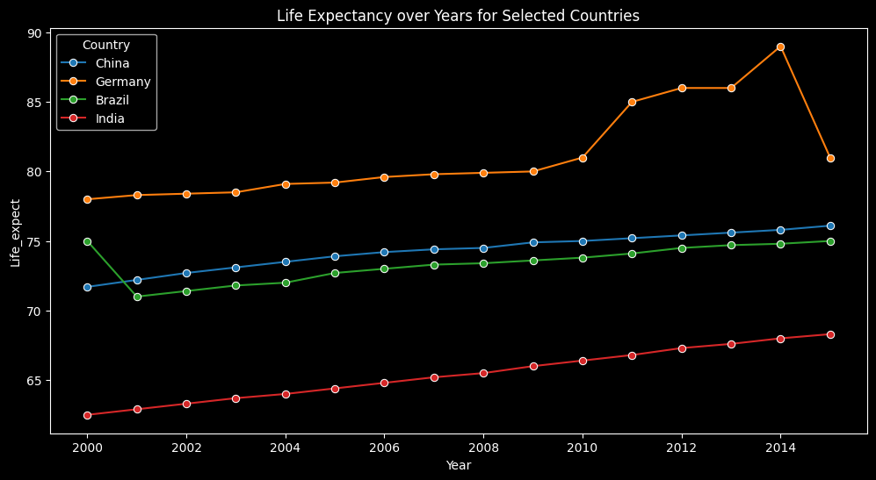
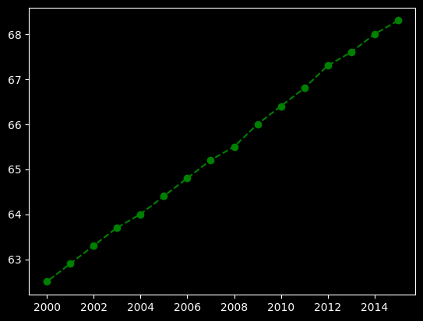
EDA : Lineplot

Slide 13
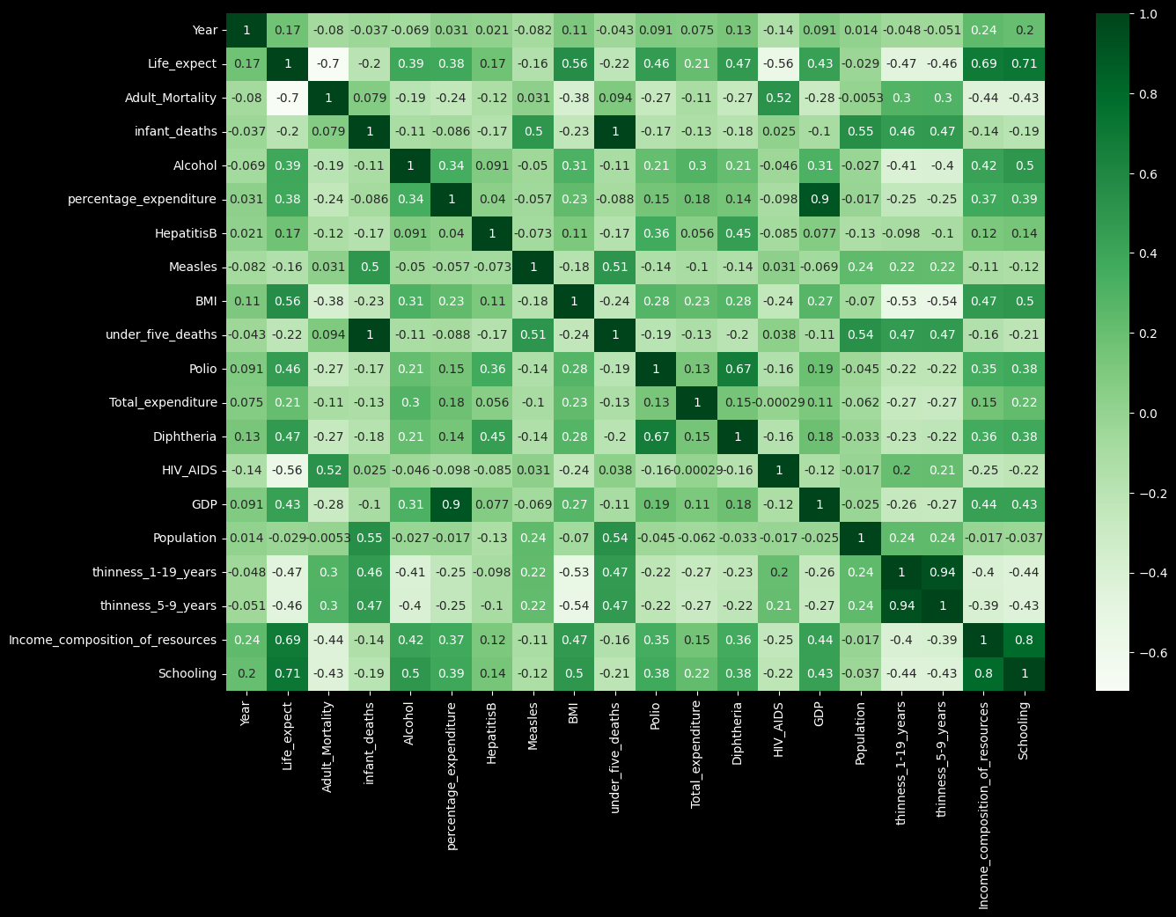
EDA : Heatmap

Slide 14
Graphs Used for Exploratory Data Analysis
Boxplot
Distribution Plot
Count Plot
Bar plot
Pie plot
Line plot
Violin plot
Heatmap
Rel plot

Slide 15
Algorithms used
Linear Regression
Scaled Data
Polynomial Regression
Decision Tree
Random Forest
Bagging
AdaBoost
Gradient Boost
XGBoost
KNN (K-Nearest Neighbors)
SVM (Support Vector Machine)

Slide 16
3
Conclusion and Next Steps

Slide 17
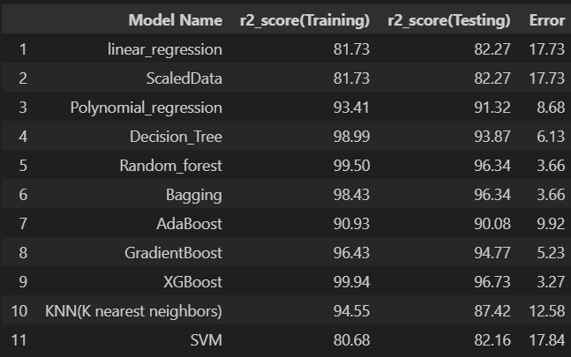
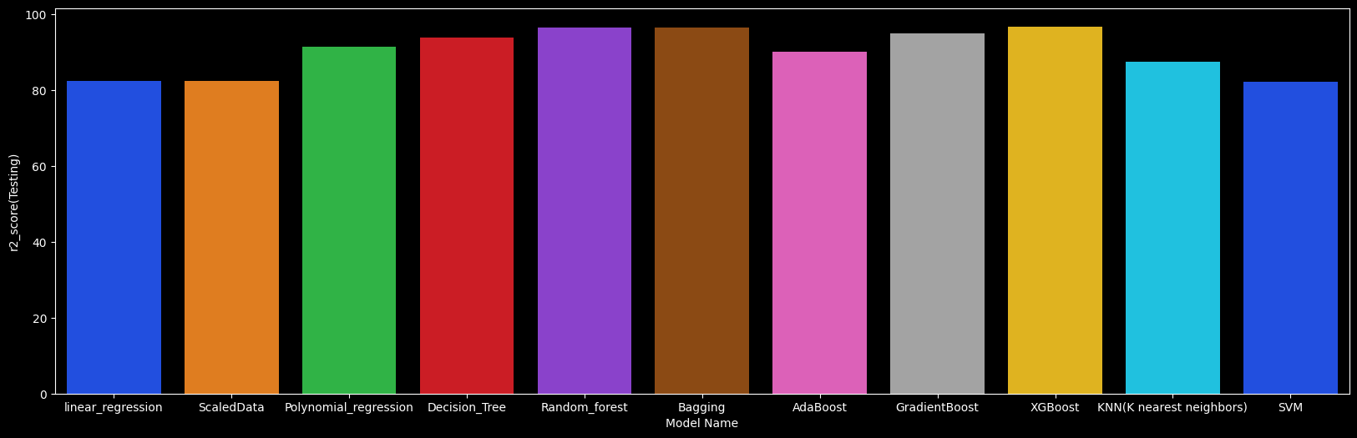
Conclusion

Slide 18
Conclusion
The best algorithm for your Life Expectancy Prediction based on performance metrics is:
XGBoost
Training R² Score: 99.94%
Testing R² Score: 96.73%
Error: 3.27 (Lowest among all models)

Slide 19

Contacts
Sanket Shendge
+91 7709136080
https://github.com/Sanketsvs7456323366vsdhgvsahdgv
sanketshendge.rmdssoe.comp@gmail.com
https://www.linkedin.com/in/sanket-shendge-33b082271/

Slide 20
Thank You !

